Slide 1

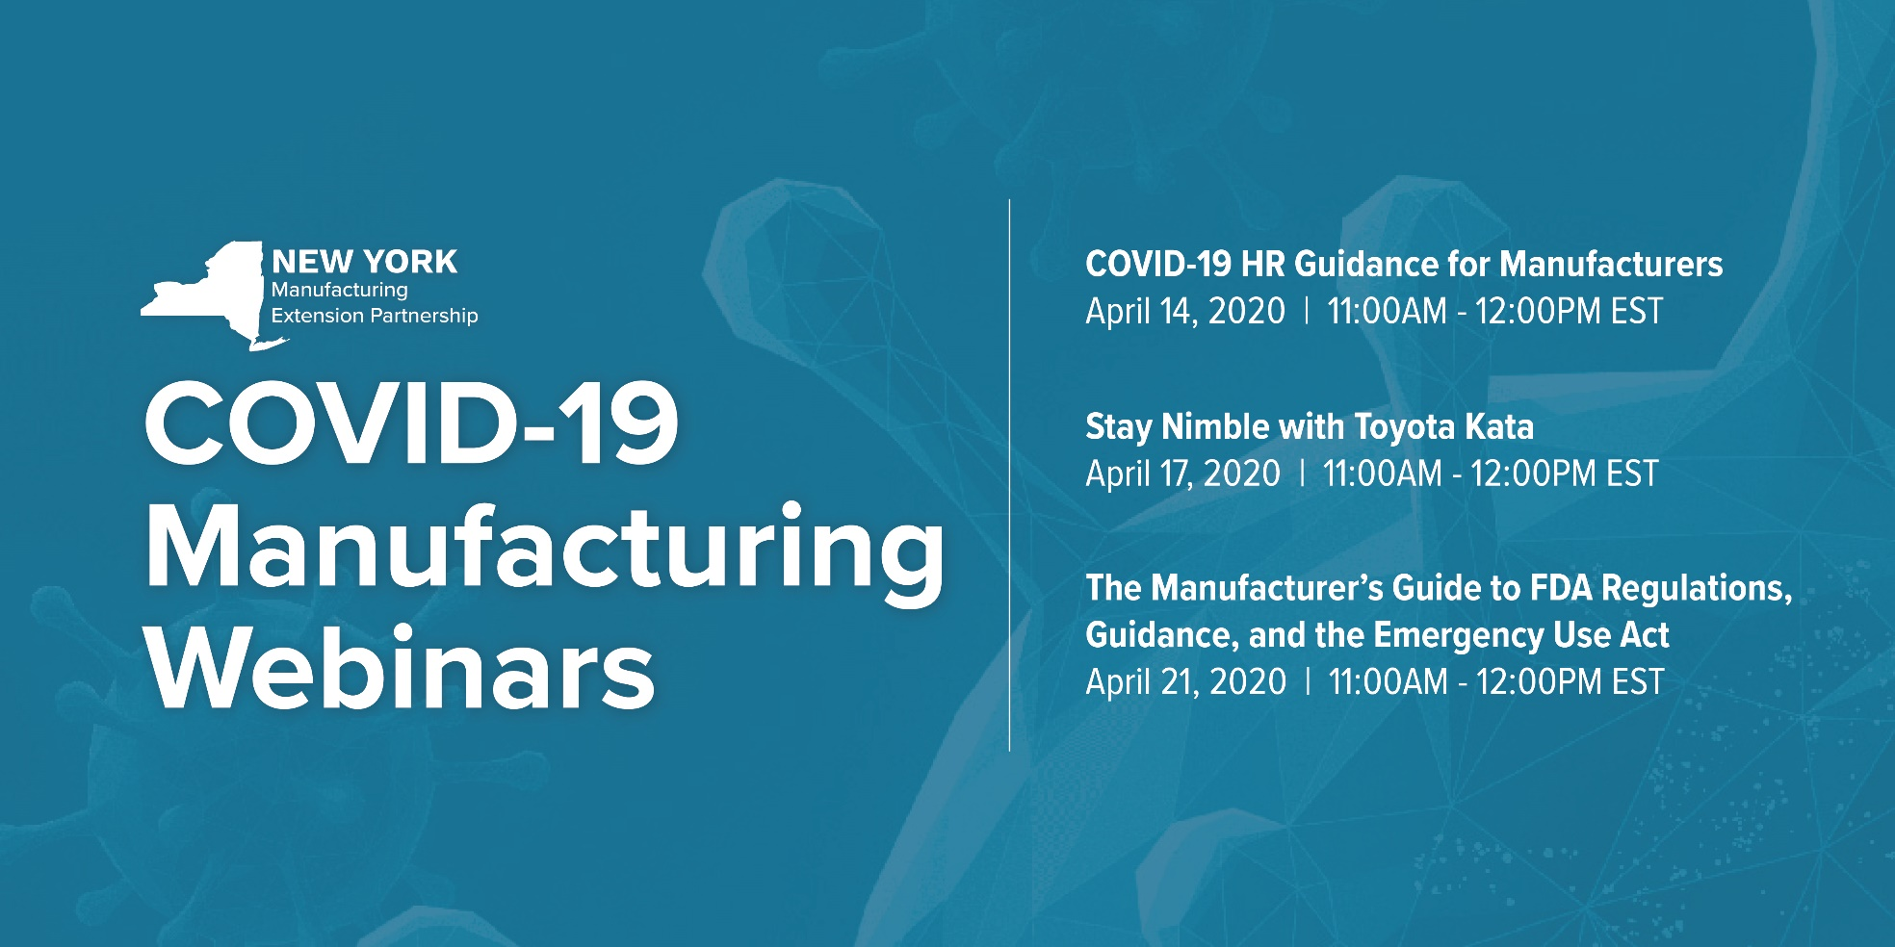


Slide 2

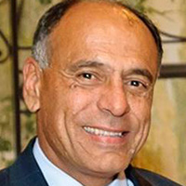

Our
Presenters
John A. Monteiro
Senior Consultant
Pinnacle Human Resources, LLC
Rose Miller
President
Pinnacle Human Resources, LLC

Slide 3


About Pinnacle Human Resources
Pinnacle Human Resources is a NYS Certified Women Owned Business with a staff of over 20 HR professionals, who perform HR assessments, employee handbooks, on-site and off-site HR back office support, managerial training, executive coaching, compensation and performance systems.
The team’s expertise is in human resources consulting that:
  Provides HR advice and expert HR best practices
  Helps clients implement employment laws and programs
  Specialize in employee relations and address concerns

Slide 4


NOTICE
The content of this webinar has been prepared for informational purposes only. This is not legal advice. We recommend that before acting on the basis of any information or material, you should consult with a Human Resources Professional or your attorney.

Slide 5

Agenda
Unprecedented Times
Government’s Response to COVID-19 Epidemic:
  Emergency Paid Sick Leave Act (EPLSA)
  Emergency Family and Medical Leave. Expansion Act, amending the Family and Medical Leave Act of 1993 (EFMLEA)
  New York State COVID-19 Sick Leave
  The CARES Act and Payroll tax credits for employer paid leave payments under EPSLA or EFMLEA
Frequently Asked Questions
Questions/Answers

Slide 6
The 2020 COVID-19 Pandemic
Life will never be the same! As the virus spread, the impact on manufacturers was great:
Shut down of non-essential manufacturers
Businesses able to continue with Work From Home
Essential manufacturers and production choices/mandates
Each of these scenarios presented unique employee issues, concerns and decisions to be made.
The need for good HR advice is essential.

Slide 7
Deeper Dive
New York State Law
  New York COVID-19 Sick Leave Law
Federal Law
  Families First Coronavirus Response Act

Slide 8
Families First Coronavirus Response Act and New York COVID-19 Sick Leave Law
Both signed on March 18, 2020
NYS Law was effective immediately (March 18)
Federal law became effective on April 1, 2020 (FFCRA)
Both have been dynamic and require interpretation
US DoL has issued 3 revisions/updates to their FAQ

Slide 9
Families First Coronavirus Response Act and New York COVID-19 Sick Leave Law
Federal Law sunsets on December 31, 2020
NYS Law does not have a sunset provision
Both Laws offer job protection to the employee
Both Laws offer continuation of benefits while on leave under the Laws

Slide 10
New York State Law
Provides employees, based on employer size and revenue, job protection and financial compensation in the event they, or their minor dependent child, are subject to a mandatory or precautionary order of quarantine or isolation issued by the state of New York, the Department of Health, local board of health, or any government entity duly authorized to issue such order due to COVID-19.

Slide 11
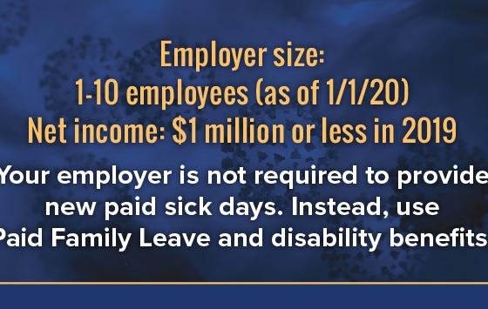
New York State Law

Slide 12
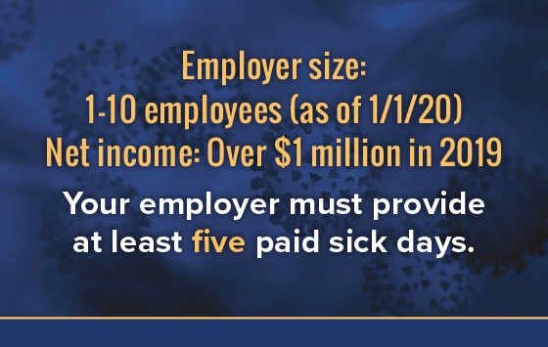
New York State Law

Slide 13
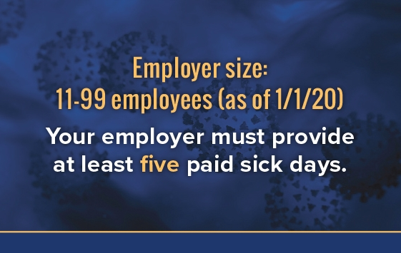
New York State Law

Slide 14
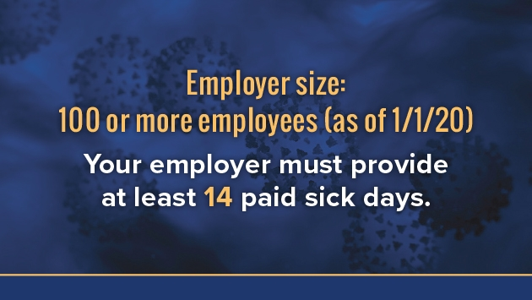
New York State Law

Slide 15
New York State Law
April 1, 2020
FFCRA Becomes Effective
FFCRA Becomes Primary
What Happens to the NYS COVID-19 Sick Leave law?

Slide 16

New York State Law
COVID-19 Reason for Leave | Employee’s max. Weekly Benefits | Eligibility Period
NY Law as primary benefit | A qualified quarantine meeting specific NY requirements* *(Must have order of quarantine that meets the NYS requirements) | $2,884.62 | March 18-31 Thereafter only if you exceed the Federal law’s salary cap and can file for supplemental benefits bridging between the Federal and State caps.

Slide 17

New York State Law
COVID-19 Reason for Leave | Employee’s max. Weekly Benefits | Eligibility Period
Federal Law | Federal, State, or local Order for Quarantine/Isolation | $2,555* | April 1 and onward
 | Self-quarantine as advised by a health care provider.
 | Experiencing symptoms and waiting for diagnosis.
NY Law for supplemental benefits | A qualified quarantine meeting specific* NY requirements *(Must have order of quarantine that meets the NYS requirements) For New Yorkers making between $132,860 and $150,000 per year | Up to $329.62 | April 1 and onward
New York State
Laws

Slide 18
Federal Law
Families First Coronavirus Response Act (FFCRA)
Establishes a federal emergency paid-leave benefits program
2 Paid Leave Components
    Emergency Paid Sick Leave Act (EPSLA)
    Expanded FMLA (EFMLA)

Slide 19
Families First Coronavirus Response Act
Applies to employers with fewer than 500 employees
Requires that employers provide their employees Emergency Sick Leave and Family Leave related to COVID-19
Provides employers with a tax credit to cover the cost of the leave
Allows for an exemption from the Law for “small businesses” with fewer than 50 employees
Took effect on April 1, 2020 and expires of December 31, 2020
Employers must Post Notice regrading the Act

Slide 20
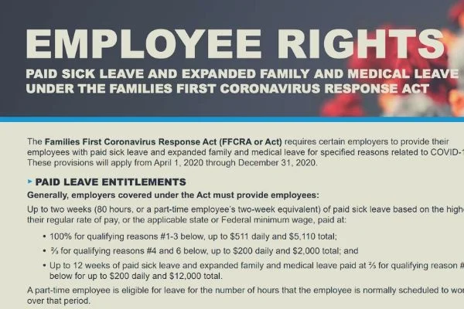
FFCRA
Workplace Poster Requirement

Slide 21
Emergency Paid Sick Leave Act (EPSLA)
Six qualifying reasons for EPSLA benefits:
Employee is subject to Federal, State, or local quarantine or isolation order related to COVID-19
Employee has been advised by a HCP to self-quarantine due to concerns related to COVID-19
Employee is experiencing symptoms of COVID-19 and seeking a medical diagnosis

Slide 22
Emergency Paid Sick Leave Act (EPSLA)
Six qualifying reasons for EPSLA benefits (continued):
Employee is caring for an individual who either is subject to quarantine or isolation order related to COVID-19 or has been advised by a HCP to self-quarantine due to concerns related to COVID-19;
Employee is caring for child whose school/place of care, childcare provider is unavailable, due to a COVID-19 related reason
Employee is experiencing any other substantially similar condition specified by the Secretary of Health and Human Services.

Slide 23
Emergency Paid Sick Leave Act (EPSLA
Two weeks (up to 80 hours) of paid sick leave at the employee’s regular rate of pay where the employee is unable to work because the employee is quarantined (pursuant to Federal, State, or local government order or advice of a health care provider), and/or experiencing COVID-19 symptoms and seeking a medical diagnosis; or
Two weeks (up to 80 hours) of paid sick leave at two-thirds the employee’s regular rate of pay because the employee is unable to work because of a bona fide need to care for an individual subject to quarantine (pursuant to Federal, State, or local government order or advice of a health care provider), to care for a child (under 18 years of age)

Slide 24
Emergency Paid Sick Leave Act (EPSLA)
School or child care provider is closed or unavailable for reasons related to COVID-19, and/or the employee is experiencing a substantially similar condition as specified by the Secretary of Health and Human Services, in consultation with the Secretaries of the Treasury and Labor
Up to an additional 10 weeks of paid expanded family and medical leave at two-thirds the employee’s regular rate of pay where an employee, who has been employed for at least 30 calendar days, is unable to work due to a bona fide need for leave to care for a child whose school or child care provider is closed or unavailable for reasons related to COVID-19

Slide 25
Emergency Paid Sick Leave Act (EPSLA)
Calculation of Pay:
For leave reasons (1), (2), or (3):
employees taking leave are entitled to pay at either their regular rate or the applicable minimum wage, whichever is higher, up to $511 per day and $5,110 in the aggregate (over a 2-week period)
For leave reasons (4) or (6): employees taking leave are entitled to pay at 2/3 their regular rate or 2/3 the applicable minimum wage, whichever is higher, up to $200 per day and $2,000 in the aggregate (over a 2-week period)

Slide 26
Emergency Paid Sick Leave Act (EPSLA)
Calculation of Pay:
For leave reasons (4) or (6):
employees taking leave are entitled to pay at 2/3 their regular rate or
2/3 the applicable minimum wage, whichever is higher,
up to $200 per day and $2,000 in the aggregate (over a 2-week period)

Slide 27
Tax Credits to Employers
Q: Is the Government Going to Help with Costs of Mandatory Paid Leave That Employers are Being Forced to Pay During this Time of Financial Hardship?
A: Yes. The Federal Law provides covered employers (both nonprofit and for-profit) with refundable payroll tax credits that reimburse them for their paid sick and family leave payments under the law. The credits are applicable to the employer’s portion of Social Security taxes for 100% of the qualified sick leave and family leave wages paid by the employer in accordance with the law.

Slide 28

Frequently Asked Questions
Q: What is the main differences between the FFCRA and the NYS COVID-19 Sick Leave?
A: The Major differences between the two are:
1) FFCRA became primary benefit as of 4/1/2020.
2) NYS COVID-19 only recognizes Orders For Mandatory Or Precautionary Quarantine in order to receive benefits.

Slide 29
Frequently Asked Questions
Q: The Families First legislation passed by Congress and signed by the President provides full-time employees with 80 hours of paid sick leave. If my company already provides this benefit, do I have to provide two additional weeks? Is there a size limit for companies? Does it apply to part-time employees?
A: Yes, this Emergency Sick Leave Act time is in addition to any other sick time provided by the employer. This Act applied to employers with 500 or fewer employees. Part-time employees are entitled to the number of hours worked, on average, over a two-week period.

Slide 30
Frequently Asked Questions
Q: My company is a small business with less than 50 employees. Do I have to comply?
A: Yes. However, small employers with less than 50 employees may seek a hardship waiver when the imposition of some of the requirements if they would jeopardize the viability of the business.

Slide 31
Frequently Asked Questions
Q: The manufacturing line is not conducive to “social distancing” rules. How do I comply?
A: Many manufacturers are using split shits or rotating schedules so that an amount of employees on the line can space themselves out. Otherwise, you must implement all the PPE similar to what is found in hospital settings.

Slide 32
Frequently Asked Questions
Q: What is the relationship of expanded FMLA to the Emergency Paid Sick Leave? How much does it pay?
A: The first 10 days may be unpaid, but the employee may elect to substitute accrued vacation leave, personal leave, or medical or sick leave for unpaid leave. Leave is paid at two-thirds of salary after the 10 days for up to 12 weeks.

Slide 33
Frequently Asked Questions
Q: Is the federal government providing a tax credit to help businesses offset the cost of the sick time and FMLA?
A: Yes. The FFCRA provides businesses with tax credits to cover certain costs of providing employees with required paid sick leave and expanded family and medical leave for reasons related to COVID-19, from April 1, 2020, through December 31, 2020. The credits are subject to limits. The IRS has issued guidance indicating that businesses are allowed a credit in an amount equal to 100 percent of the qualified sick leave wages and qualified family leave wages paid by the employer.

Slide 34
Frequently Asked Questions
Q: If we have an employee that admitted to having contact with an individual infected with COVID-19.What is our legal right as an employer to require them to go home? If we do send them home, what is our financial obligation to that employee?
A: If an employee self discloses that he or she has had close contact with another individual who has positively contracted COVID-19, the employer may send the employee home, and require that the employee remain at home to protect the other employees in the workplace from being infected, for the recommended 14-day quarantine period.

Slide 35
Resources
US DOL (FFCRA)
https://www.dol.gov/agencies/whd/pandemic/ffcra-questions
IRS (Sick Leave Tax Credit):
https://www.irs.gov/newsroom/covid-19-related-tax-credits-for-required-paid-leave-provided-by-small-and-midsize-businesses-faqs#how_to_claim
NYS COVID-19 Law:
https://paidfamilyleave.ny.gov/COVID19

Slide 36

Questions from our Audience?

