Slide 1
Lead Your Team Through Change: The Importance of Communicating with Your Employees
CITEC Business Solutions
Presented by: Sharon Van Auken
Business Advisor at CITEC MEP Center

Slide 2


CITEC provides consulting and training services to help businesses grow. We work across the seven-county North Country region, mostly with small and medium-sized manufacturers, and other businesses and organizations as well. Our focus areas are continuous improvement / lean / efficiency, safety, marketing and business development, human resources, leadership development, and executive services.
Visit us at citec.org.
CITEC, like FuzeHub, is part of the MEP National Network, a public-private partnership that delivers comprehensive, proven solutions to US manufacturers.
Sharon Van Auken is the Human Resources specialist for CITEC Business Solutions. In this role she assists businesses with leadership and soft skills training, as well as HR documentation, compliance and coaching. During her career, she has served as an HR Director, corporate trainer, instructional designer and technical editor. Her experience spans a variety of fields including financial services, energy research, hospitality and tourism, and higher education.

Slide 3
Agenda
  The Importance of a Communication Plan
  Tips for Effective Communication
  Special Care in Communicating to Employees Furloughed or Laid Off
  Potential Pitfalls
  Communicate, Communicate, and Communicate Some More
  Change is Hard – Leadership is Important

Slide 4
Polling Question
Is your organization deemed to be an
“Essential Business”?

Slide 5

Why is Regular Communication Important?
  Inform
  Reassure
  Engage

Slide 6

Benefits of an Effective Communication Plan
  Offers a clear explanation of what has changed and why
  Lets employees know the timeframe for changes, given the best information that you have
  Describes how operations will function in the weeks ahead
Increased responsibilities
Perceived lack of time
Changes in eating and sleeping habits
Lack of self-care – exercise, nutrition, relaxation
Studying
New relationships, old friends not present
Competing for jobs, internships, scholarships
Mastering large amounts of information in small amounts of time

Slide 7
Benefits of an Effective Communication Plan
  Forges unity among employees and with the organization
  Reminds employees what your organization does best
  Reminds employees how your organization supports the local and global community
  Focuses on the positive aspects of the changes
Increased responsibilities
Perceived lack of time
Changes in eating and sleeping habits
Lack of self-care – exercise, nutrition, relaxation
Studying
New relationships, old friends not present
Competing for jobs, internships, scholarships
Mastering large amounts of information in small amounts of time

Slide 8

General Tips for Successful Communication
Be authentic, even if you don’t know the path forward yet – authenticity builds trust!
Demonstrate empathy toward employees, especially in times of crisis and change
Field employees’ questions and be honest, even if you don’t have the answer
Create a communication plan for regular and ongoing communication to employees
Designate
Change Champions to help

Slide 9

Informing Employees
Wealth of information to be communicated….
Good hygiene practices
Specific safety protocols and new policies
New cleaning practices and schedules
Protective equipment and to use it
Changes to the workday structure
Changes to products, customers, vendors
Personal resources – mental health, childcare
Leave and other benefits

Slide 10
Polling Question
Has your organization developed a
return-to-work safety plan yet?

Slide 11

Reassuring Employees
Important Considerations:
Consistent messaging
Frequent messaging
2-way dialogue between employees
and leaders – listening and addressing
employee concerns

Slide 12

Reassuring Employees
Comprehensive training
Initial and periodic messages from CEO
(can be virtual or recorded)
Daily updates and check-ins
from managers
Idea box – online with a dedicated
email address
Continually updated listings/postings
of resources

Slide 13

Engaging Employees
Communication is also a great way to engage employees.
Keeps those currently working focused on tasks at hand
Keeps those furloughed or laid off connected to your business

Slide 14
Engaging Employees
Here are some suggestions:
Provide a forum for sharing positive stories from work and the community – post to internal web sites, bulletin boards
Continue to celebrate successes, share ideas and solutions
Hold virtual celebrations if some employees
are still working remotely
Create a challenge posed to employees
Keep employee recognition programs alive
or start new ones

Slide 15
Communication to Those Furloughed or Laid Off
Be authentic and empathetic – you hope these employees will rejoin your organization
Explain why the furlough or lay off is necessary – it’s not performance
Offer as many specifics as possible about how the furlough or lay off will occur, how long it may last, how employees will be notified
Coordinate with Human Resources to describe how wages and benefits will be handled, and where to apply for UI if appropriate
Provide resources for additional information
Provide an opportunity for employees to ask questions, or a resource for them to go to with questions
“Always treat your employees exactly as you want them
to treat your best customers” -- Stephen R. Covey

Slide 16
Polling Question
Has your business furloughed
or laid off employees?

Slide 17
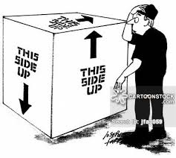
Potential Pitfalls
  Mixed messaging
  Silence – beginning in earnest
  but not following through
  Indicating that you have
  information but can’t share it yet

Slide 18

Communicate, Communicate, and
Communicate Some More
7 times in 7 mediums
Various communication mediums:
  Announcement meetings – even virtual
  Daily briefings – even virtual
  Email
  Intranet or other internal medium
  Newsletter
  Letters
  Signs and posters
  FAQ

Slide 19
Change is Hard – Leadership is Important
Never is leadership more important than in times like this
Without a plan, and communication about the plan, employees will feel like they are on a rudderless ship
Great change leaders need to employ all of their soft skills and emotional intelligence
Frequent and clear messaging is crucial to bringing employees along
Don’t forget to listen to employees – their insight can help uncover problems and innovative solutions

Slide 20
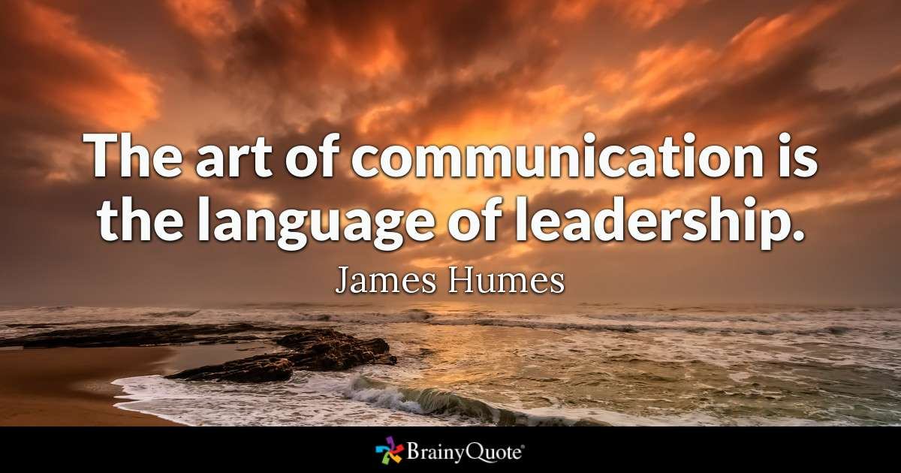
Change is Hard – Leadership is Important

Slide 21
Questions?
Thank you.
Sharon Van Auken
Business Advisor / Human Resources
vanauken@citec.org
518/907-4481
www.citec.org

